Slide 1



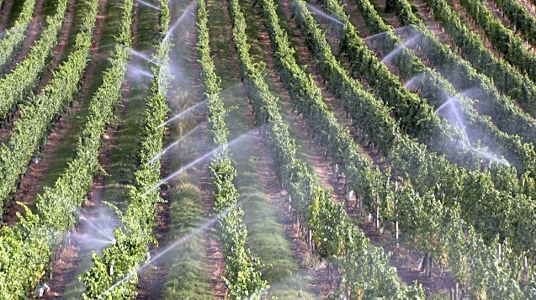
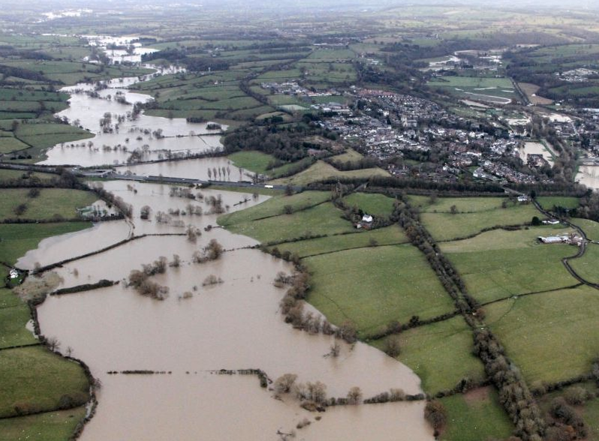
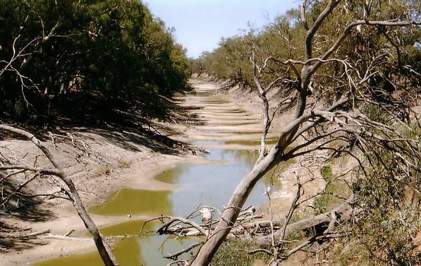
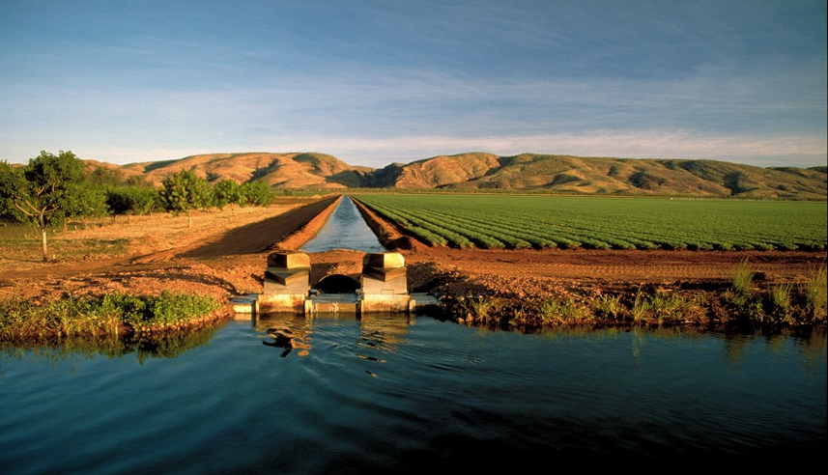
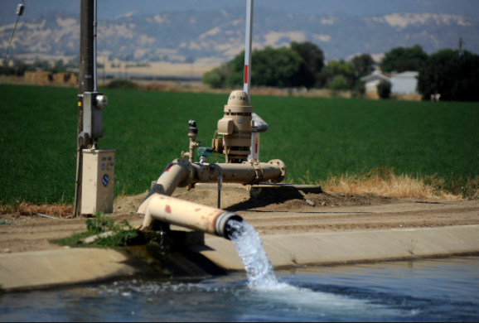
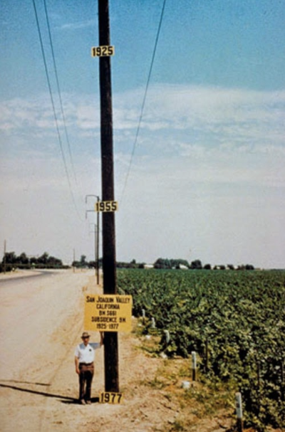
Fingerprinting Irrigation in Sparsely Gauged Basins
Minghui Zhang; Sally Thompson, PhD
University of California, Berkeley
Human activity disrupts PUB efforts
Irrigation can be tracked in streamflow fingerprints
Irrigation causes predictable water crisis syndromes
“Predictions in ungauged basins” (PUB) efforts traditionally focus on natural basins.
However, including human activity in PUB efforts is essential given the high level of development of many basins.
Percent change in streamflow metrics (α, λ, and average streamflow) serve as fingerprints that differentiate among irrigation sources. These fingerprints vary across catchment type, .
Water crisis syndromes of: (1) unsustainability (aquifer depletion), (2) ecological destruction (perturbation of natural streamflow volume), and (3) social impact (irrigation needs unmet) are combined into a water crisis metric.
We explored the effects of irrigation on streamflow dynamics and environmental sustainability.
Our work supports PUB efforts in heavily irrigated, but sparsely gauged, basins.
For arid catchments, river cannot supply irrigation and change in metrics is zero
Expand PUB methods to irrigated basins
Fingerprints differ across sources and catchment types
Irrigation is provided without negative impact
Irrigation needs are unfulfilled, but cause water crisis
Source: Jim Hawthorne Photography
Source: Daily Republic
α decreases as irrigation generates frequent, but smaller, streamflow peaks.
1. Exploration
Model streamflow resulting from four separate irrigation sources.
2. Prediction
Relate irrigation regimes back to streamflow.
α
Hydrograph of an arid catchment illustrates the fingerprints attributed to four irrigation sources.
Average streamflow decreases for shallow aquifer sourcing, and increases for imports.
Model
Three streamflow metrics: α, λ, average streamflow, describe changes attributable to irrigation.
average Q
Imports increase streamflow magnitude and peak frequency
In addition to fingerprints, two scenarios allow us to eliminate certain source possibilities. Catchments that belong to these scenarios are unlikely to use that source.
Periodic irrigation causes “saw-tooth” pattern
Irrigation is triggered at 60% of field capacity.
These contour plots allow us to construct theoretical fingerprints for each source, to be compared to measured fingerprints.
Contact
References
Minghui Zhang
University of California, Berkeley
Email: minghuiz@berkeley.edu
Phone: (510) 883 4186
Botter, G; Porporato, A; Rodriguez-Iturbe, I; Rinaldo, A. “Basin-scale soil moisture dynamics and the probabilistic characterization of carrier hydrologic flows: Slow, leaching-prone components of the hydrologic response”. Water Resources Research, 43, 2007.
Porporato, Amilcare; Daly, Edoardo; and Rodriguez-Iturbe, Ignacio. “Soil water balance and ecosystem response to climate change”. The American Naturalist, 164:5, 2004.
Srinivasan, V; Lambin, EF; Gorelick, SM; Thompson, BH; and Rozelle, S. “The nature and causes of the global water crisis: Syndromes from a meta-analysis of coupled human-water studies”. Water Resources Research, 48: 2011.

